Slide 1
Chapter - 5
Dynamic Programming

Slide 2
Dynamic Programming
Well known algorithm design techniques:.
  Divide-and-conquer algorithms
Another strategy for designing algorithms is dynamic programming.
  Used when problem breaks down into recurring small subproblems
Dynamic programming is typically applied to optimization problems. In such problem there can be many solutions. Each solution has a value, and we wish to find a solution with the optimal value.

Slide 3
Divide-and-conquer
Divide-and-conquer method for algorithm design:
Divide: If the input size is too large to deal with in a straightforward manner, divide the problem into two or more disjoint subproblems
Conquer: conquer recursively to solve the subproblems
Combine: Take the solutions to the subproblems and “merge” these solutions into a solution for the original problem

Slide 4
DP Vs Divide-and-Conquer
Divide-&-conquer works best when all subproblems are independent.
    So, pick partition that makes algorithm most efficient & simply combine solutions to solve entire problem.
    Divide-&-conquer is best suited for the case when no “overlapping subproblems” are encountered.
Dynamic programming is needed when subproblems are dependent;
    we don’t know where to partition the problem
    In dynamic programming algorithms, we typically solve each sub problem only once and store their solutions in a table. But this is at the cost of space
    “Programming” refers to a tabular method

Slide 5
DP Vs Greedy Method
Both algorithms are used for obtaining optimal solution.
GM pics a optimal solution form the set of feasible solutions, where as DP does not create any feasible solution set.
DP considers all possible sequences, where as GM will not revise previously generated solutions
GM does not guarantee of getting optimum solution, where as DP will.
DP solves the sub-problems bottom up, where as GM solves the sub-problems from top down.

Slide 6
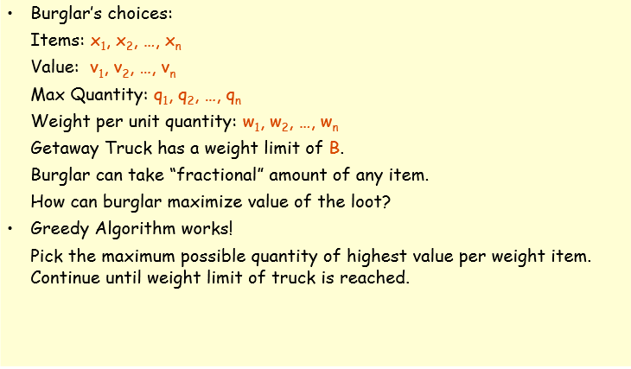
Fractional Knapsack Problem

Slide 7
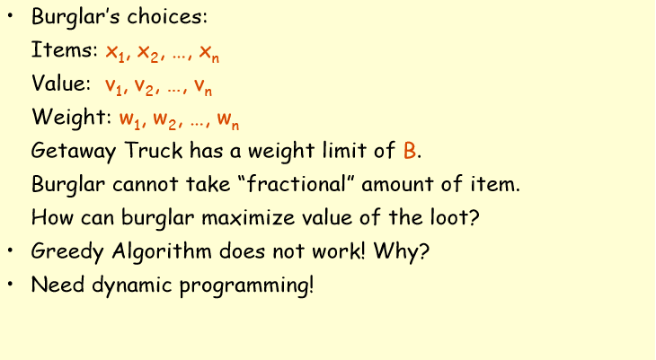
0-1 Knapsack Problem

Slide 8
Elements of Dynamic Programming (DP)
Dynamic Programming solves the sub-problems bottom up.
  The problem can’t be solved until we find all solutions of sub-problems.
  The solution comes up when the whole problem appears.
  The solution is obtained when the whole problem disappears.
  DP has to try every possibility before solving the problem.
  It is much more expensive than greedy.

Slide 9
Elements of Dynamic Programming (DP)
DP is used to solve problems with the following characteristics:
Simple subproblems
  We should be able to break the original problem to smaller subproblems that have the same structure
Optimal substructure of the problems
  The optimal solution to the problem contains within optimal solutions to its subproblems.
Overlapping sub-problems
  there exist some places where we solve the same subproblem more than once.

Slide 10
Steps to Designing a
Dynamic Programming Algorithm
Characterize optimal substructure
  Develop a mathematical notation for a given problem
2. Recursively define the value of an optimal solution
3. Compute the value bottom up
4. (if needed) Construct an optimal solution

Slide 11
Principles of Optimality
It states that
“In an optimal sequence of decisions or choices each sub sequence must also be optimal”
When it is not possible to apply this principal then we can not solve the problem using DP

Slide 12
Elements of DP
Optimal substructure:
  It uses optimality principle to find optimal solution
Overlapping subproblems:
  Problem is divided into subproblems
  Solutions of subproblems are shared to get the final solution
  Avoids repetition of work to get the solution more efficiently

Slide 13
Application of DP
0/1 Knapsack Problem
Optimal Binary Search Tree
Travelling Salesmen Problem
Multistage Graph
Reliability Design
Matrix Chain Multiplication

Slide 14
0-1 Knapsack problem
Given a knapsack with maximum capacity W, and a set S consisting of n items
Each item i has some weight w_{i} and benefit value b_{i} (all w_{i} , b_{i} and W are integer values)
Problem: How to pack the knapsack to achieve maximum total value of packed items?
The problem is called a “0-1” problem, because each item must be entirely accepted or rejected.
Just another version of this problem is the “Fractional Knapsack Problem”, where we can take fractions of items.

Slide 15
Solving 0-1 Knapsack problem by DP
Use recurrence relation as
  table [I,j] = max{table[i-1,j],v_{i} + table[i-1,w_{i}]} if j >= w_{i}
  OR
  table [i-1,j] if j < w_{i}
Initially table[0,1] = 0 as well as table[I,0] = 0 when j>=0 and i>=0
Time complexity of this algorithm is O(nW)

Slide 16
Example 1
For the given instance of problem obtain the optimal solution for the Knapsack problem
The capacity of the Knapsack is W = 5
Item | Weight | value
1 | 2 | 3
2 | 3 | 4
3 | 4 | 5
4 | 5 | 6

Slide 17
Example-1
Initially the table [0,i] = 0 and table [I,0] = 0.
  Fill up the table either row or column wise using the recurrence relation formula.
0 1 2 3 4 5
0
1
2
3
4
table [I,j] = max{table[i-1,j],vi + table[i-1, w_{i} ]} if j >= w_{i}
or
table [i-1,j] if j < w_{i}
0 | 0 | 0 | 0 | 0 | 0
0
0
0
0

Slide 18
Example 1
  table [I,j] = max{table[i-1,j],v_{i} + table[i-1,w_{i}]} if j >= w_{i}
  or
  table [i-1,j] if j < w_{i}
Table[1,1] with I,j =1; w_{i} =2 and v_{i} =3
As j < wi
Table[1,1] = table[i-1,j] = table [0,1] = 0
Table[1,1] = 0
update this value in the table

Slide 19
Example 1
The final table is
How to find knapsack items?
0 1 2 3 4 5
0
1
2
3
4
0 | 0 | 0 | 0 | 0 | 0
0 | 0 | 3 | 3 | 3 | 3
0 | 0 | 3 | 4 | 4 | 7
0 | 0 | 3 | 4 | 5 | 7
0 | 0 | 3 | 4 | 5 | 7

Slide 20
Example 1
To find final knapsack items
Start with i =4 and k =5
table[4,5] = table[3,5] so do not select 4th item
Now i = i-1; I =3, table[3,5] = table [2,5] so do not select 3rd item
Now i= i-1 = 2; table[2,5] != table[1,5] so select 2nd item.
Now i=i-1 = 1 and k= k-wi ; i=1,k=5-3= 2;
As table[1,2] != table[0,2] select 1st item.
Now i=i-1 = 0; k = 2-2 =0; so 1st and 2nd items are selected (1,1,0,0)
0 1 2 3 4 5
0
1
2
3
4
0 | 0 | 0 | 0 | 0 | 0
0 | 0 | 3 | 3 | 3 | 3
0 | 0 | 3 | 4 | 4 | 7
0 | 0 | 3 | 4 | 5 | 7
0 | 0 | 3 | 4 | 5 | 7
7
Starting point

Slide 21
Exercise 1
Using the DP solve the following problem
W=5
Item | Weight | value
1 | 1 | 12
2 | 3 | 10
3 | 2 | 6

